Slide 1
QuickMessenger
Team members:
Baran Kaya Hong Sun Sajid Rahim
Xiaodong Xu

Slide 2
1. Introduction
2. Use Cases
3. Architecture
4. State / Class diagrams
5. Conclusion

Slide 3
Introduction
“QuickMessenger’ - Instanting Messaging (IM) application
Examples: Whatsapp, Kik, Wechat
Objective
Build an IM application with extensible architecture
Friendly UI/UX, privacy protection by design with end to end encryption
Problem Statement
Collaborating across 4 team members in seperate locations
Project planning
Data management
Android/IOS how to utilise their platform features

Slide 4
1. Introduction
2. Use Cases
3. Architecture
4. State / Class diagrams
5. Conclusion

Slide 5
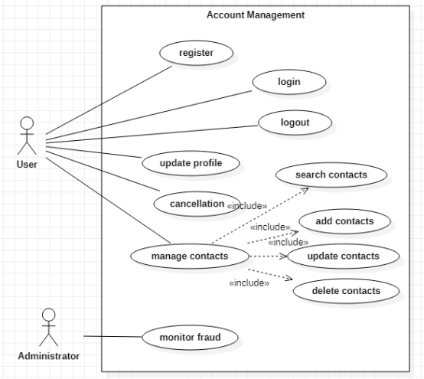
Use Case Diagram - Account Management

Slide 6
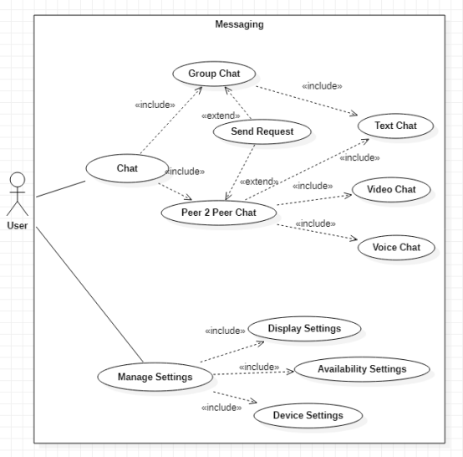
Use Case Diagram - Messaging

Slide 7
1. Introduction
2. Use Cases
3. Architecture
4. State / Class diagrams
5. Conclusion

Slide 8
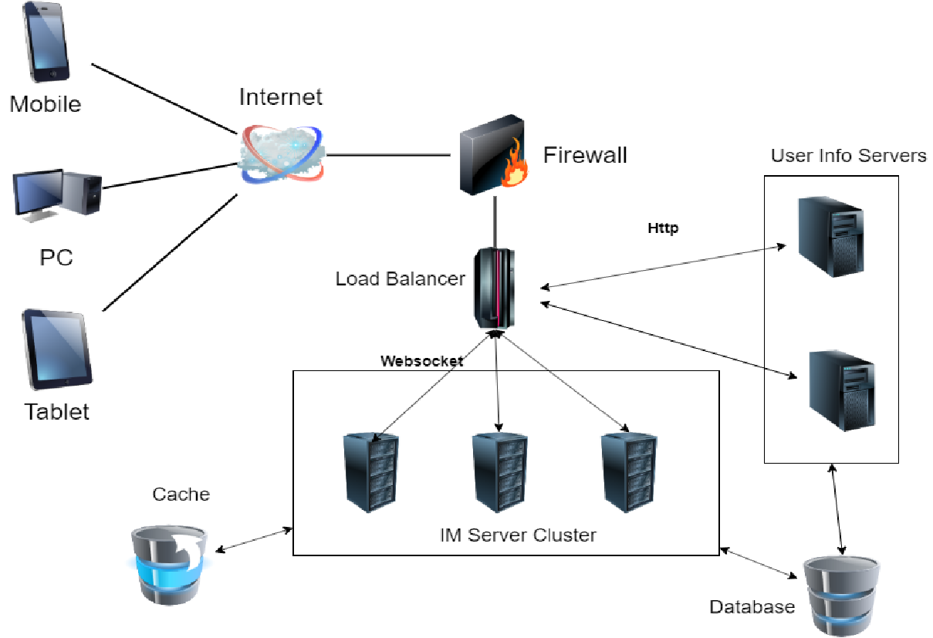
Network Topology

Slide 9
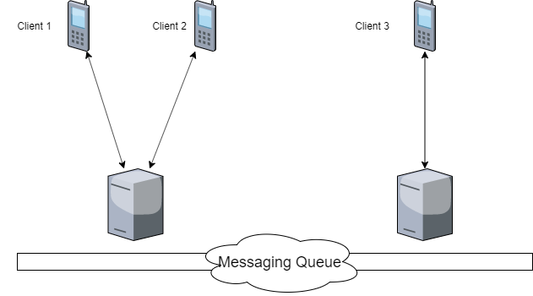
Messaging Module

Slide 10
1. Introduction
2. Use Cases
3. Architecture
4. State / Class diagrams
5. Conclusion

Slide 11
Controller State Charts
5 different state charts:
User Account State Chart
Message State Chart
Conversation State Chart
Voice/Video Call State Chart
Settings State Chart

Slide 12
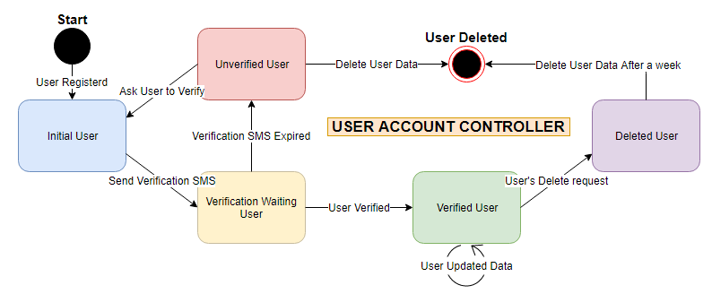
Controller State Charts
User Account State Chart

Slide 13
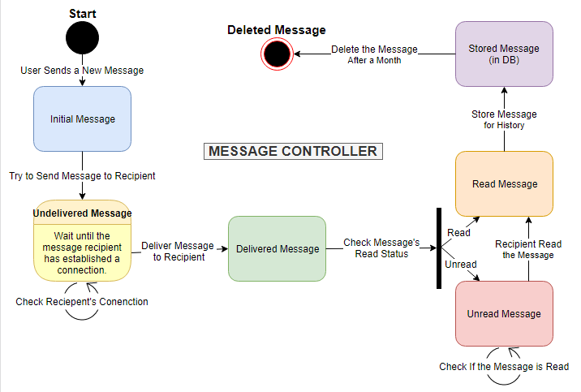
Controller State Charts
Message State Chart

Slide 14
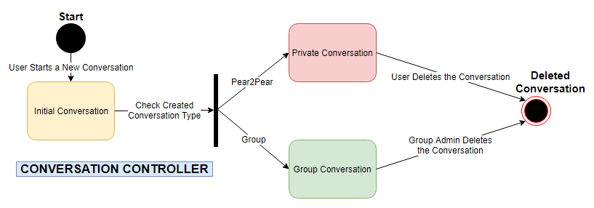
Controller State Charts
Conversation State Chart

Slide 15
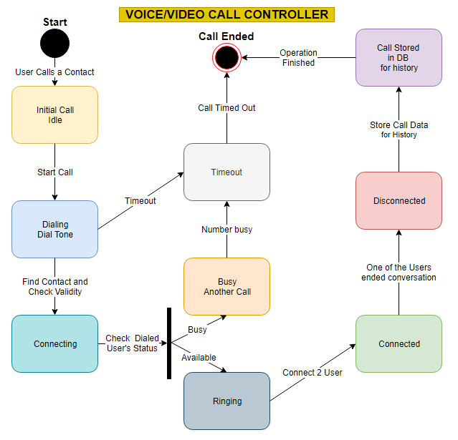
Controller State Charts
Voice/Video Call State Chart

Slide 16
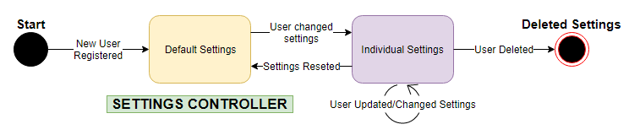
Controller State Charts
Settings State Chart

Slide 17
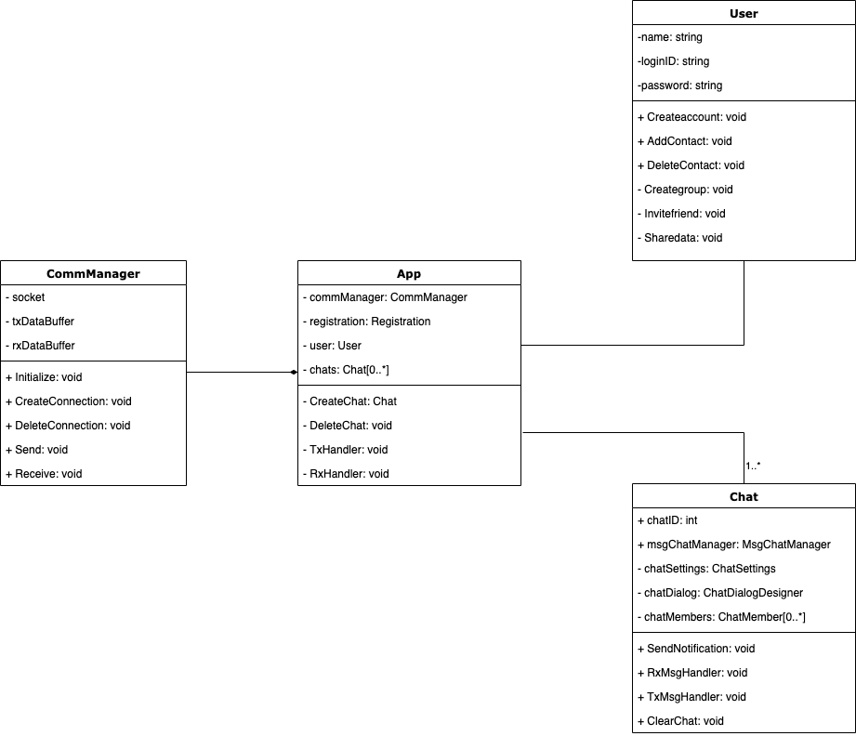
Class Diagrams - Overall

Slide 18
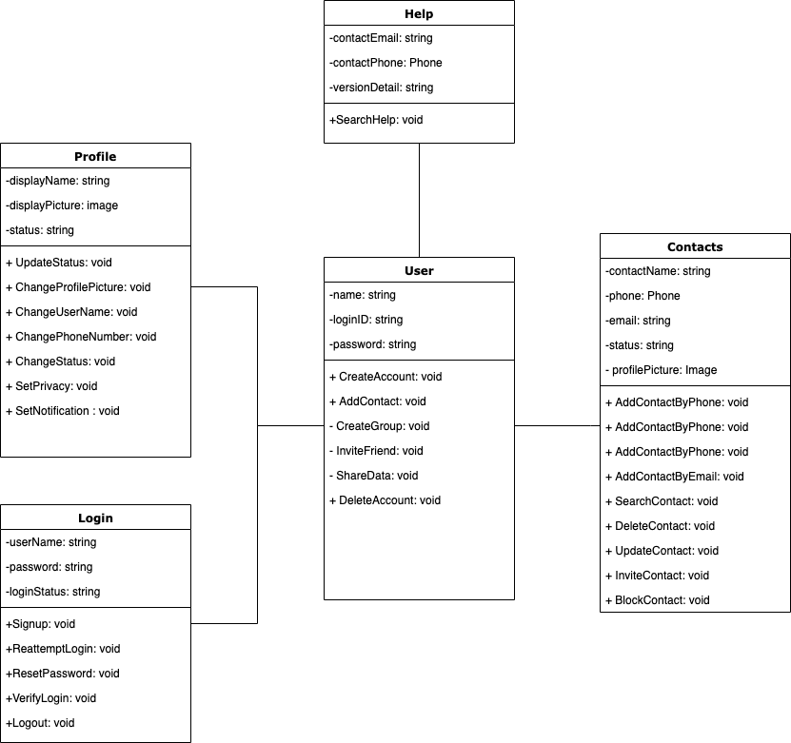
Class Diagrams - Account Management

Slide 19
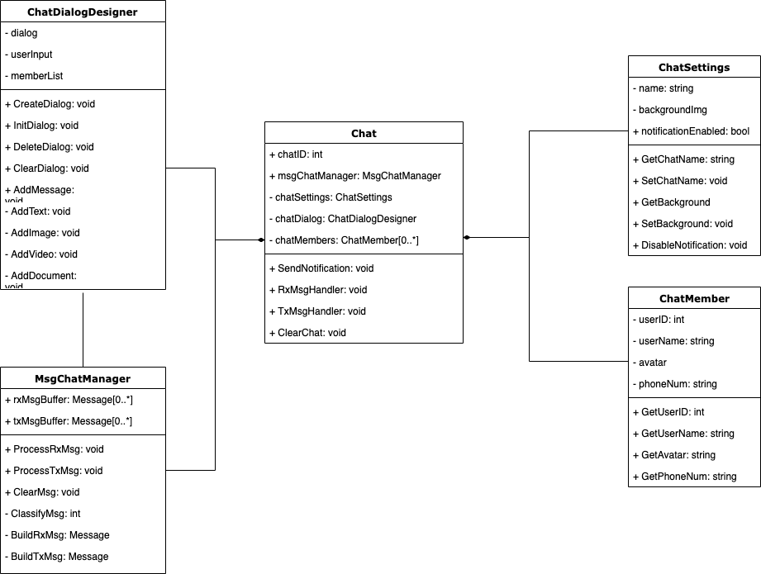
Class Diagrams - Chat

Slide 20
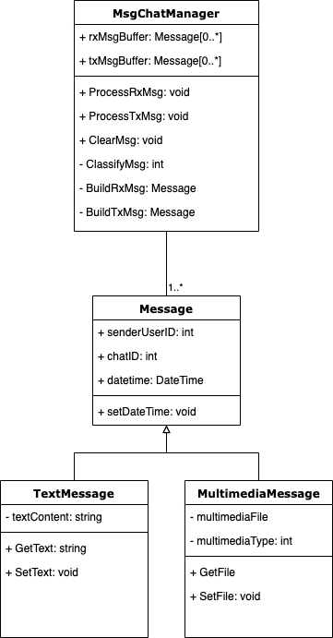
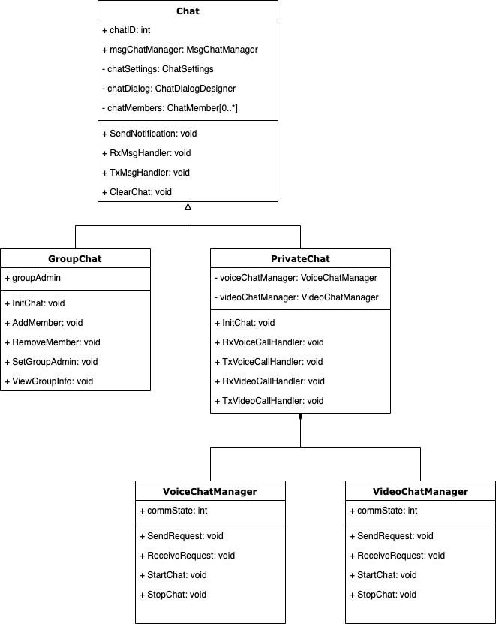
Class Diagrams - Chat

Slide 21
1. Introduction
2. Use Cases
3. Architecture
4. State / Class diagrams
5. Conclusion

Slide 22
Conclusion
Instant Messaging Mobile App QuickMessenger
Message Delivery
Multimedia File Delivery
Private and Group Chat
Future Work
Security
Separate Server for Multimedia Files
Voice/Video Call

